Slide 1
Kindergarten Curriculum Night

Slide 2
HELLO!
A Day With Kindergarten

Slide 3

Must enter through the office. You will be buzzed in twice through 2 doors.
Raptor: Must have badges to go past office.
Need to sign in using a driver’s license and will receive a name badge to go past the office. Sign out in the front office when you leave. Return your name badge.
Grade level doors
Fire Drills: Monthly
Lock-Downs & Shelter in Place: Periodically

Slide 4

CHILD SAFE NUMBER 469-752-2300
ABSENCE NOTES
  Within 3 days of return
  Can NOT accept an e-mail
TARDIES
  School OPEN at 7:00
  Classrooms OPEN at 7:25
Instruction BEGINS at 7:40

Slide 5
Arrival & Dismissal
School Zone begins at 7:00 a.m.
No left turn after 7:15
Parking: Please be mindful of signs & areas to park
Afternoon: Car tags, parking, walkers, daycare & buses
Walkers are picked up by kindergarten door by the front entrance.
Please send a note or call before 2:15 if plans for how your child goes home ever change. (Temporary or Permanent)
Students will be in the front office after 3:00 p.m.

Slide 6
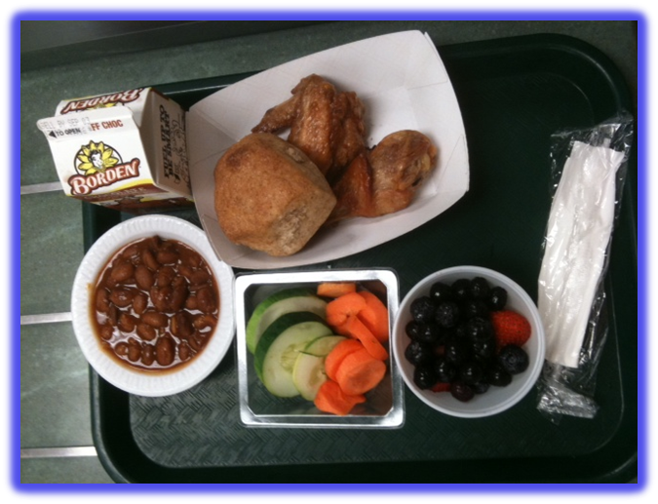
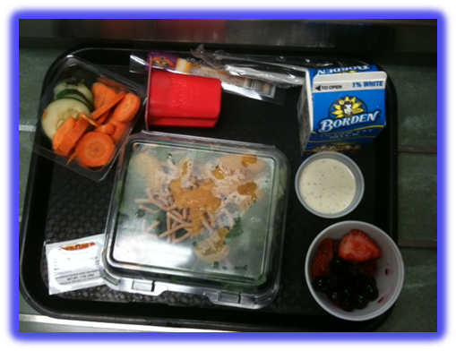
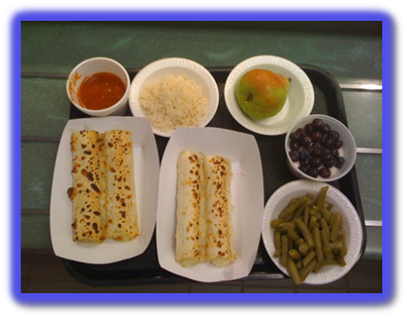

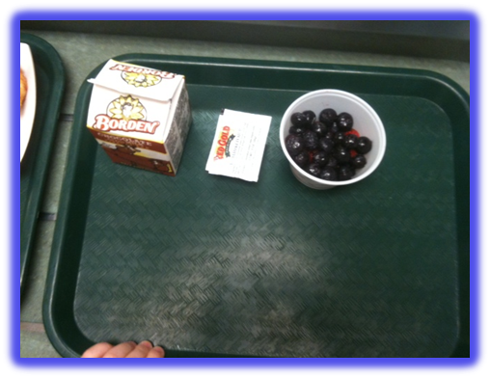

Slide 7
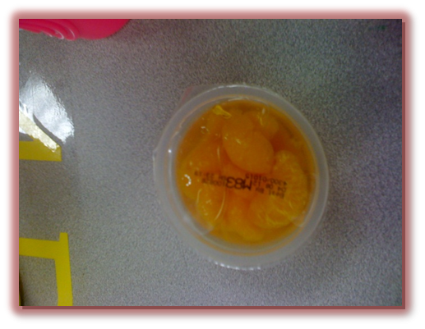
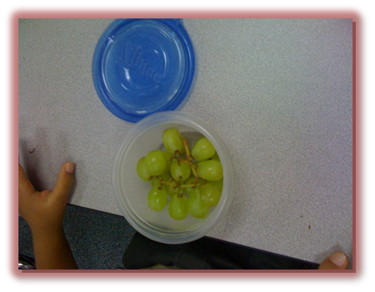
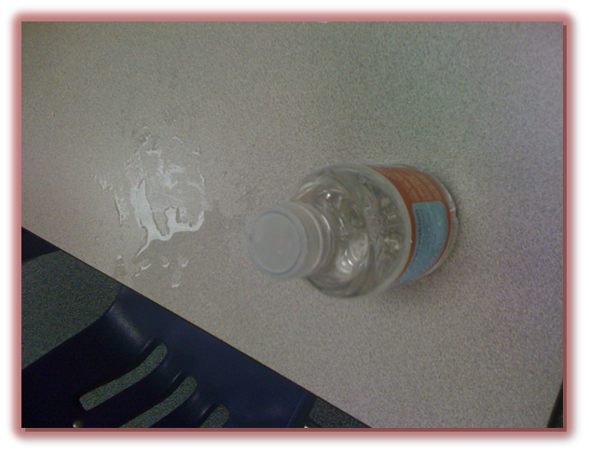
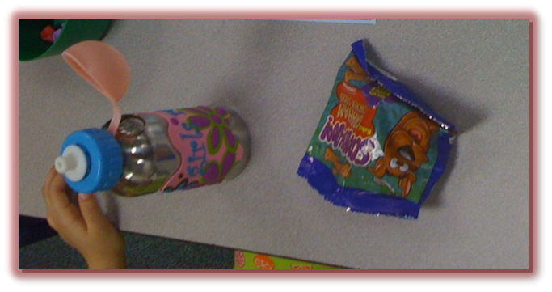
Snacks

Slide 8
Odds & Ends
Birthday Treats
We do not bring treats to school for birthdays.
Personal Belongings
Please label your child’s personal belongings including coats. Please bring an extra pair of labeled clothes to leave in their lockers.
Snacks
Your child may eat a healthy snack individually packaged or in a Ziploc bag.
Computers
Please charge computers over night and bring every day (computer & charger)

Slide 9
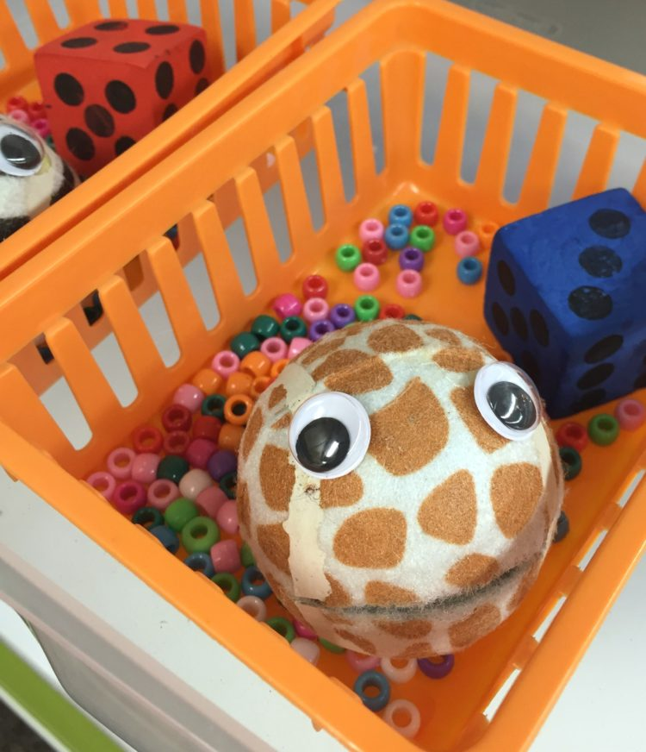
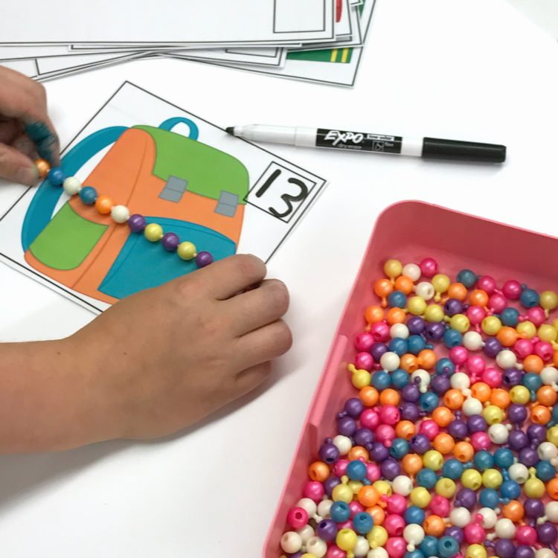
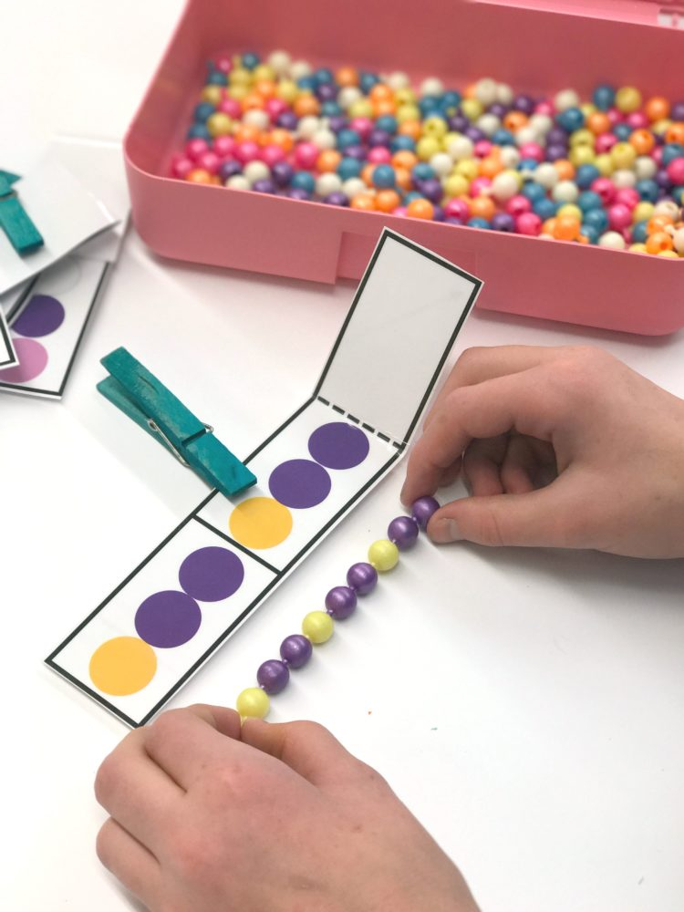
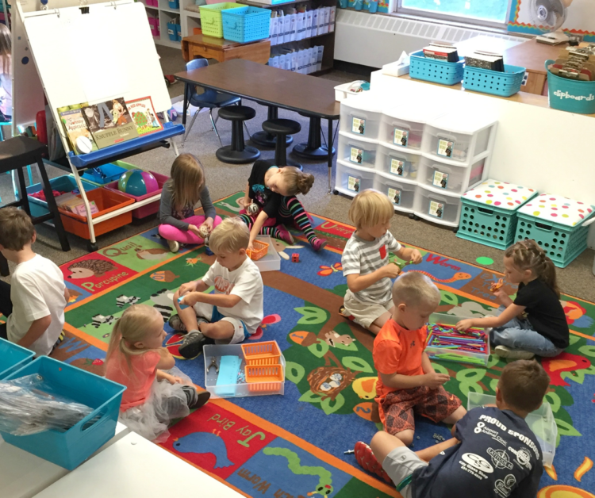
Fine Motor
Morning Stations
Notes:
https://poweredtemplate.com/childhood-free-google-slides-theme-51669/

Slide 10

Balanced Literacy
Want big impact?
Use big image

Slide 11
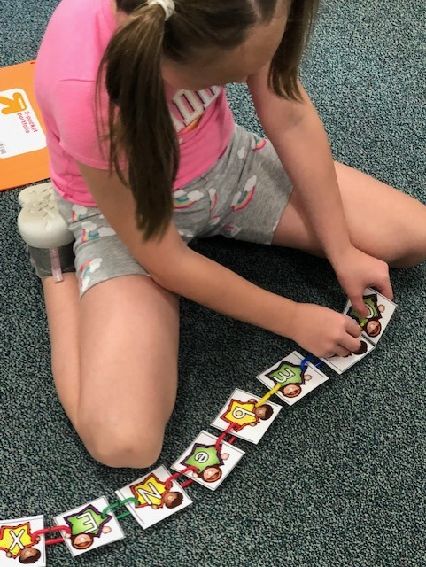
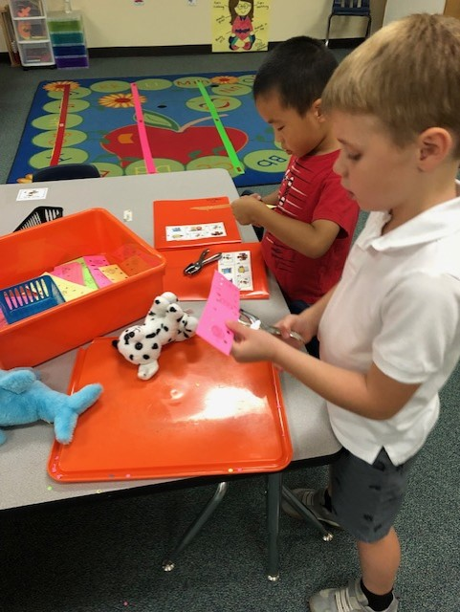
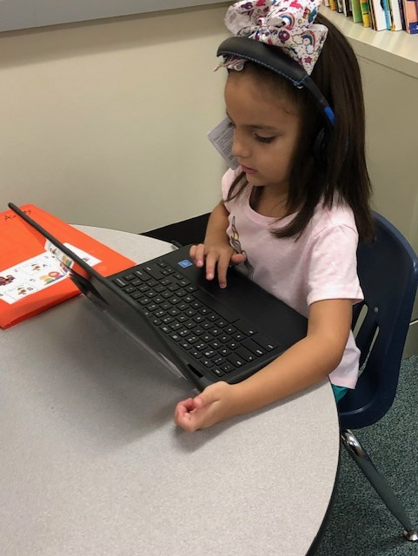
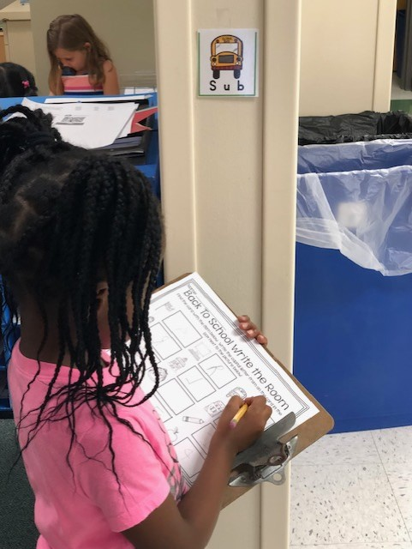
Workstations

Slide 12

Writer’s Workshop

Slide 13
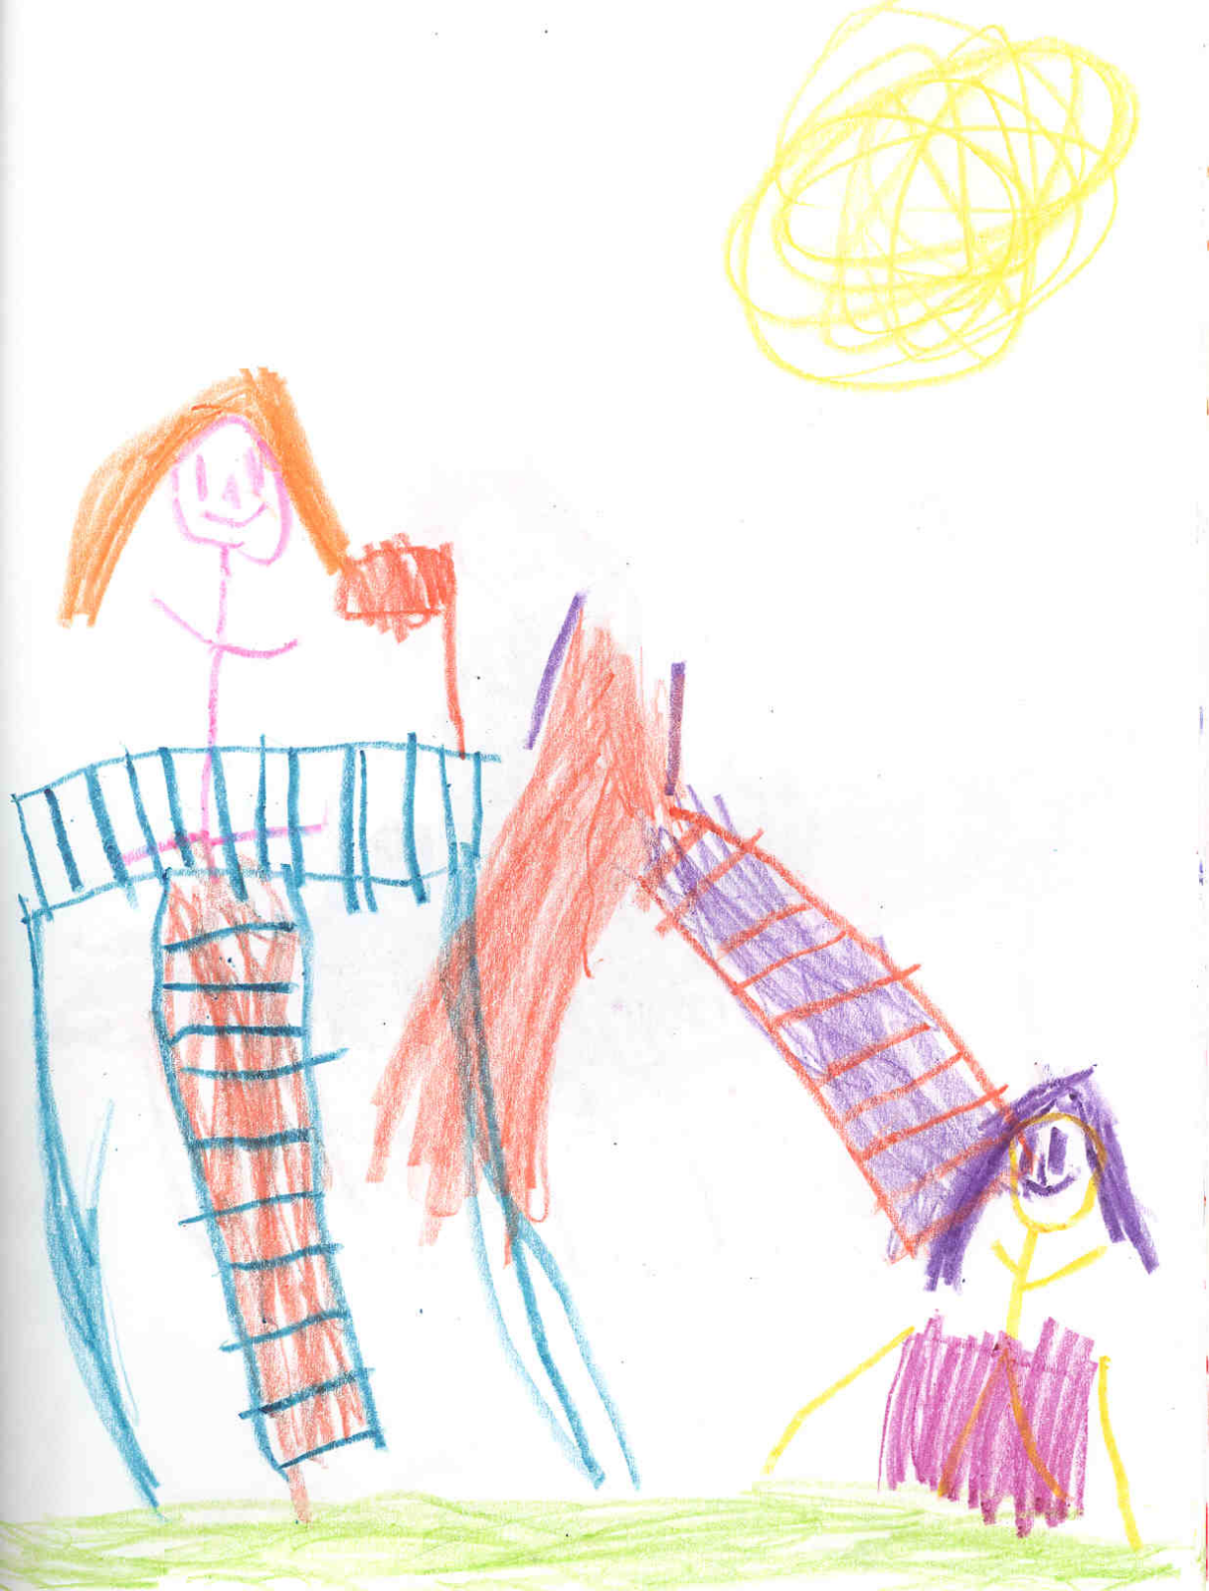
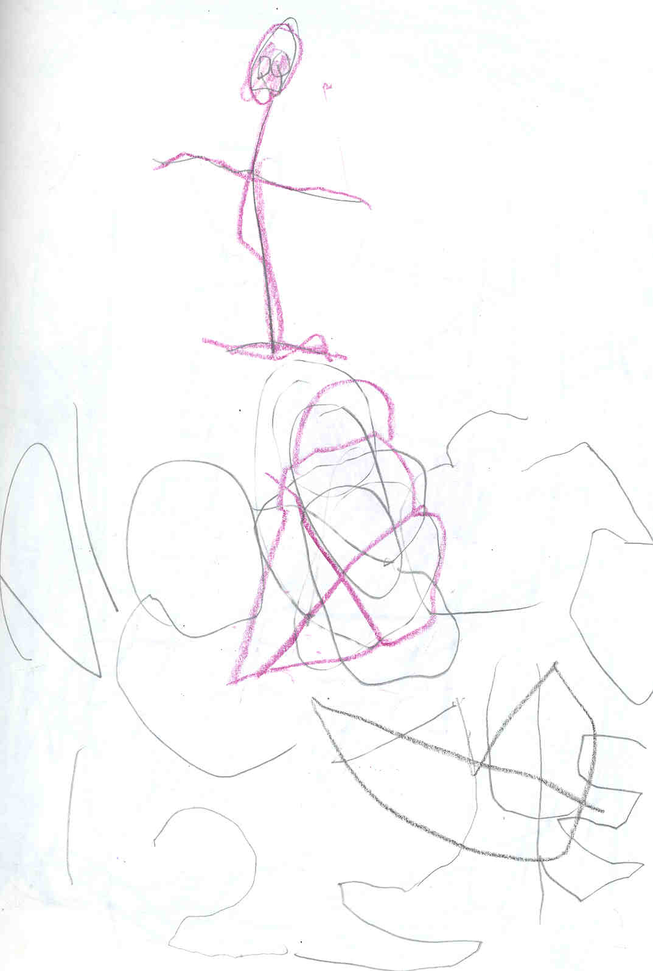
Stages of Writing
‌Drawing
‌Uses drawing to stand for writing
Believes that drawings/writing is communication of a purposeful message
Read their drawings as if there was writing on them.
‌Scribbling
Scribbles but intends it as writing
Scribbling resembles writing
Holds and uses a pencil like an adult
‌Letter-like forms
‌Shapes in writing actually resemble letters
Shapes are not actually letters
Look like poorly formed letters, but are unique creations.

Slide 14
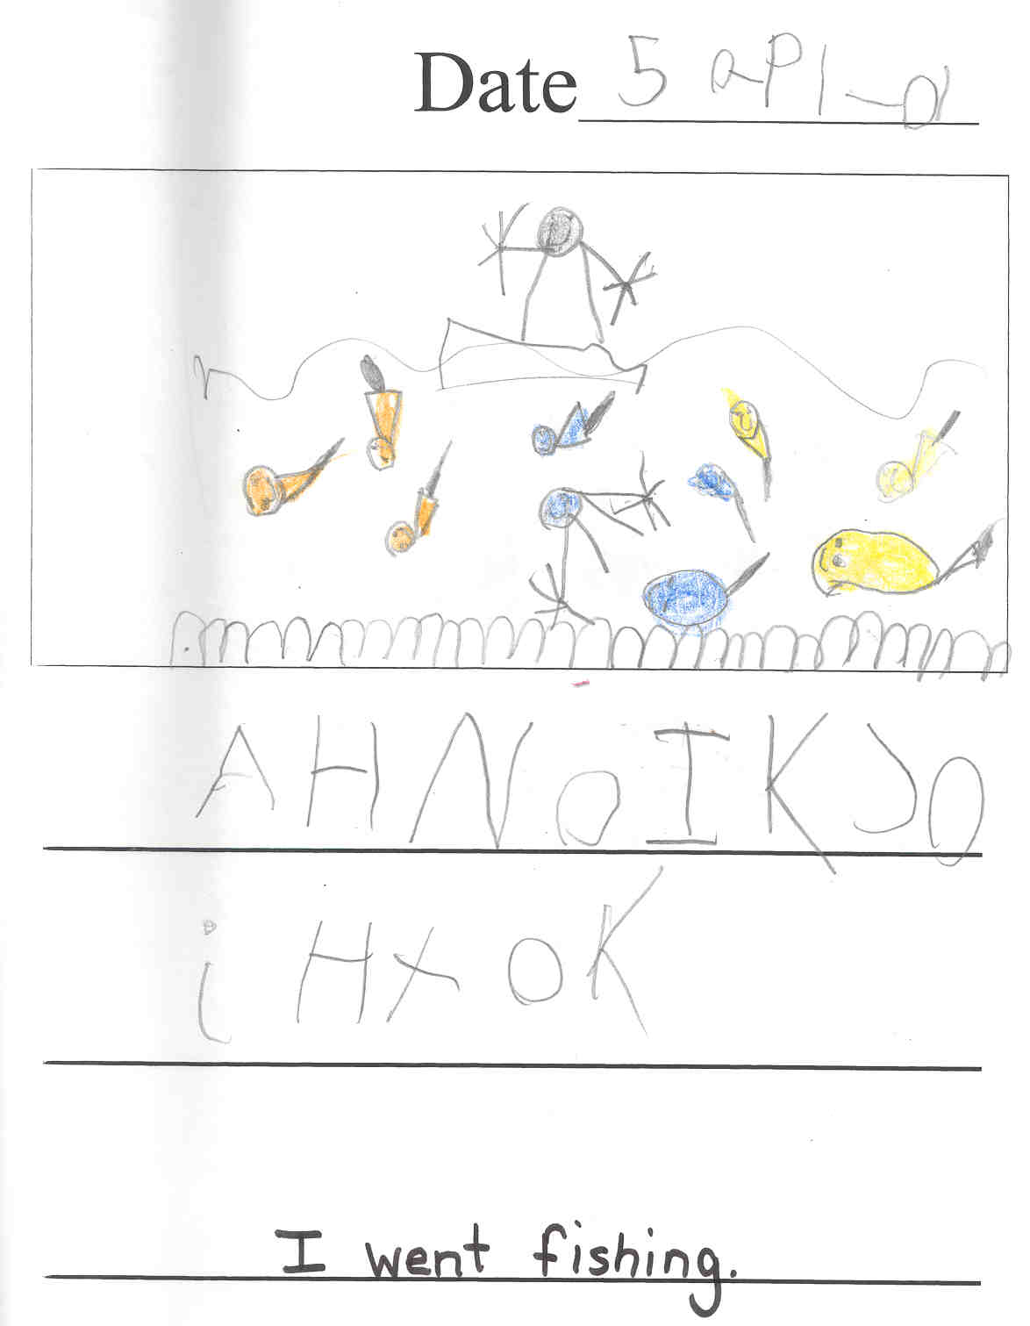
Stages of Writing
Random-letters
Uses letter sequences perhaps
learned from his/her name
May write the same letters in many ways
Long strings of letters in random order
Invented Spelling
Creates own spelling when conventional spelling is not known
One letter may represent an entire syllable
May not use proper spacing
As writing matures, more words are spelled conventionally
As writing matures, perhaps only one or two letters invented or omitted

Slide 15
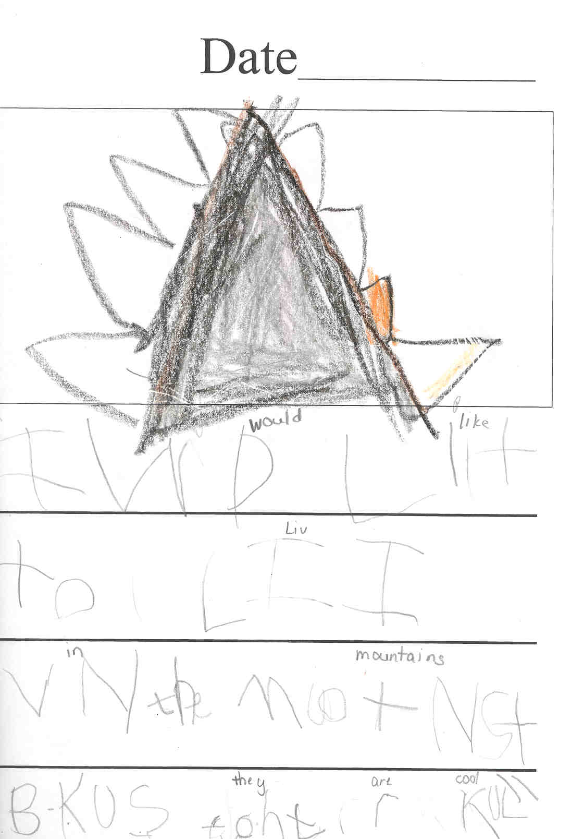
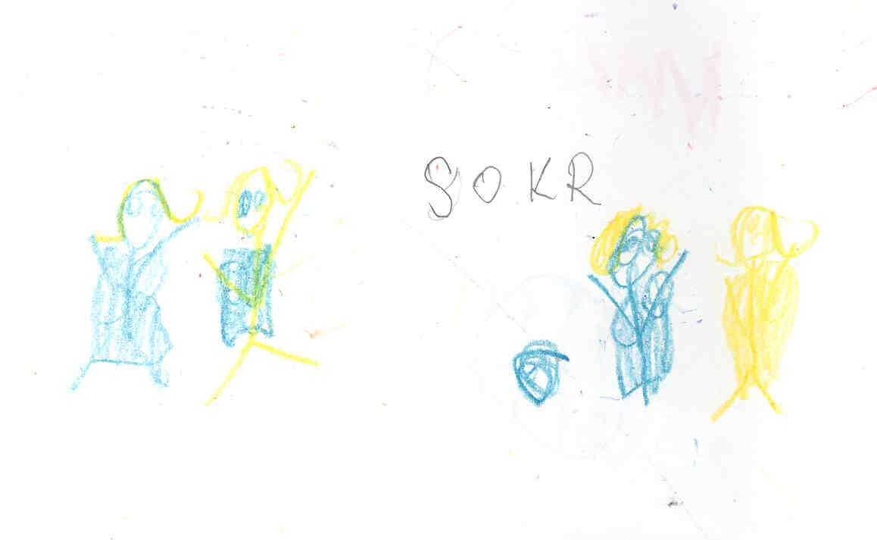
Stages of Writing

Slide 16
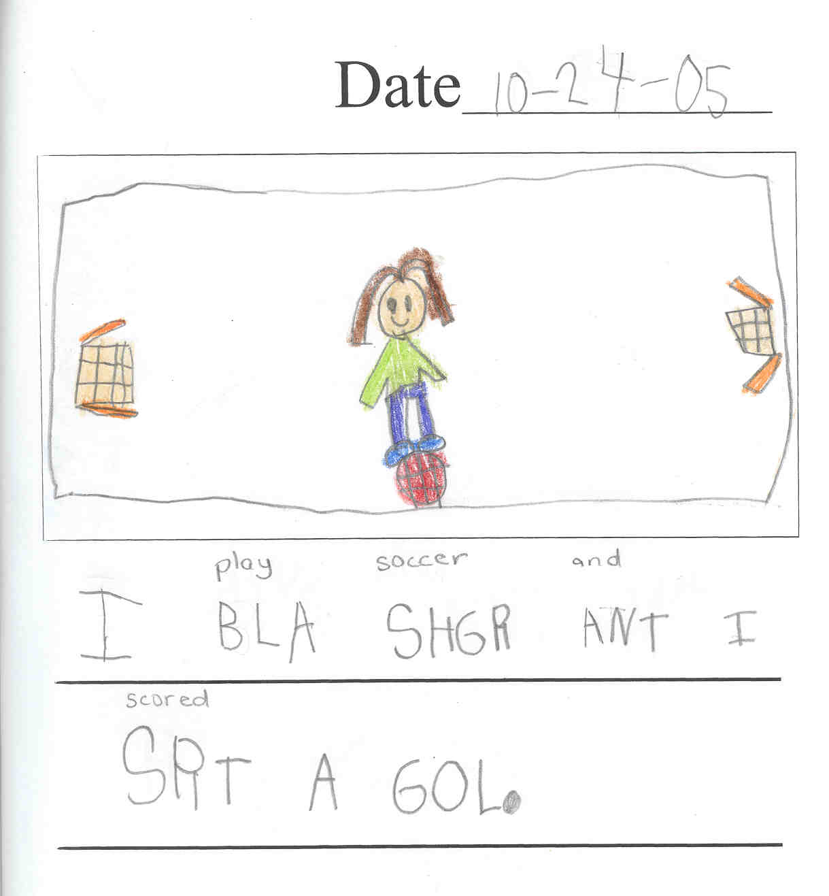
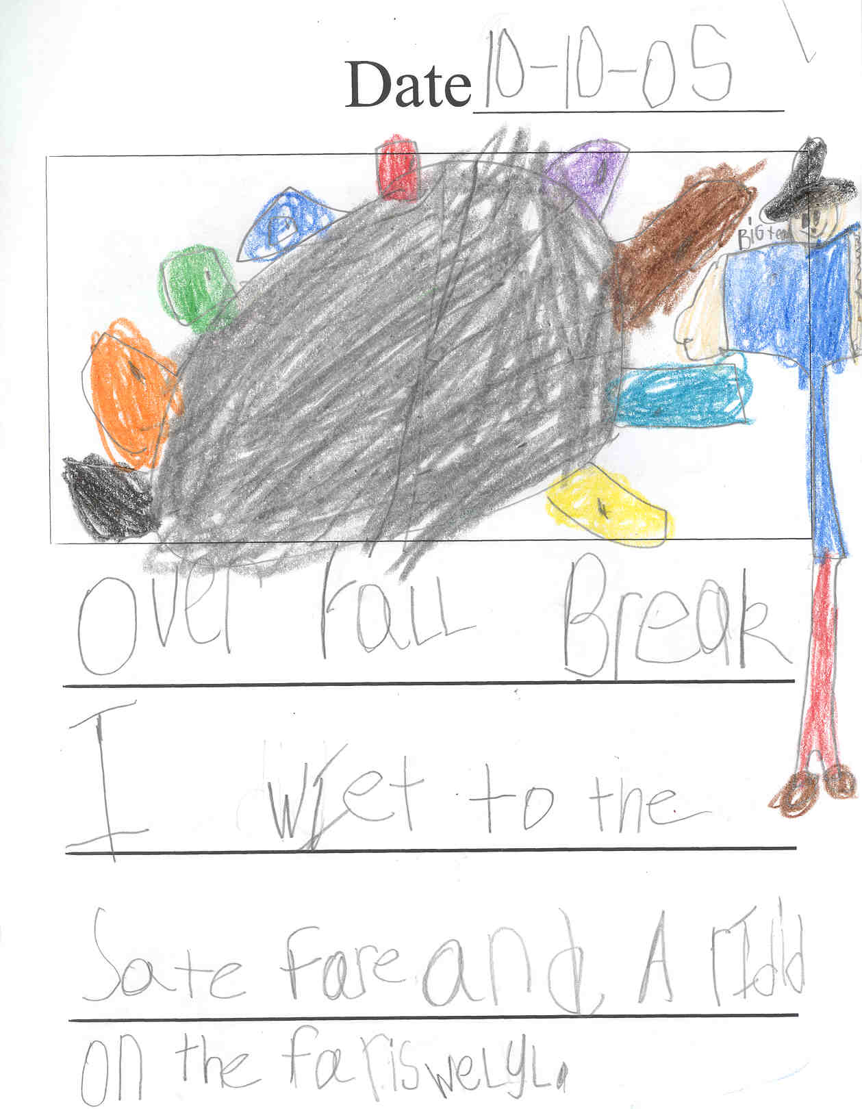
Stages of Writing

Slide 17

Math Time!!

Slide 18
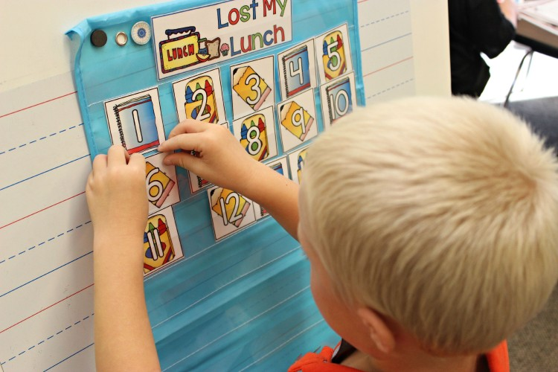
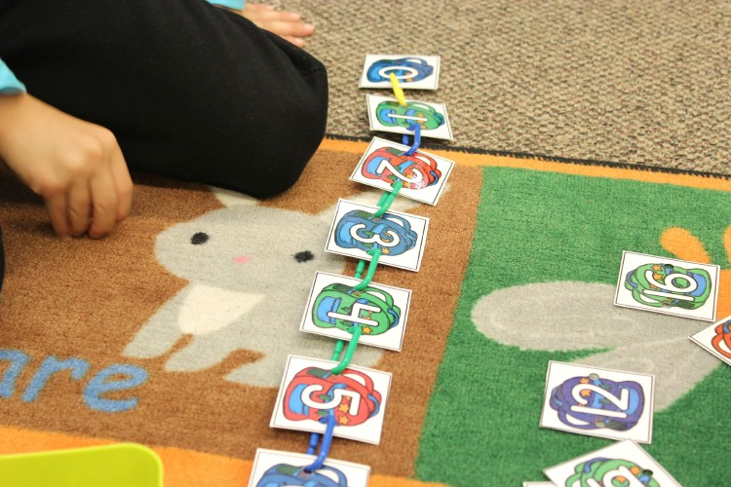
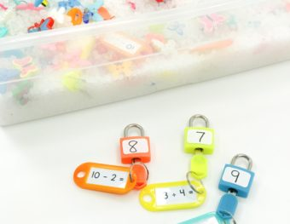


Slide 19
Science
Social
Studies
Centers

Slide 20
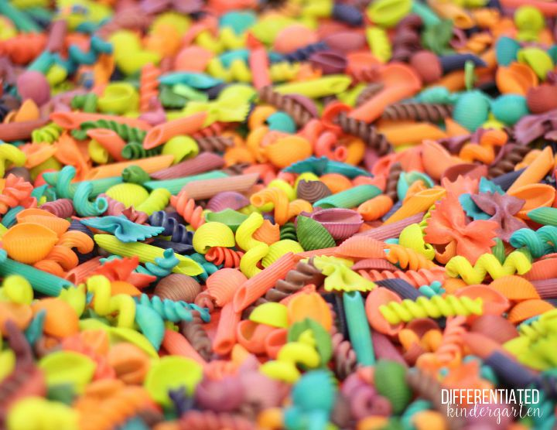
Sensory Table

Slide 21
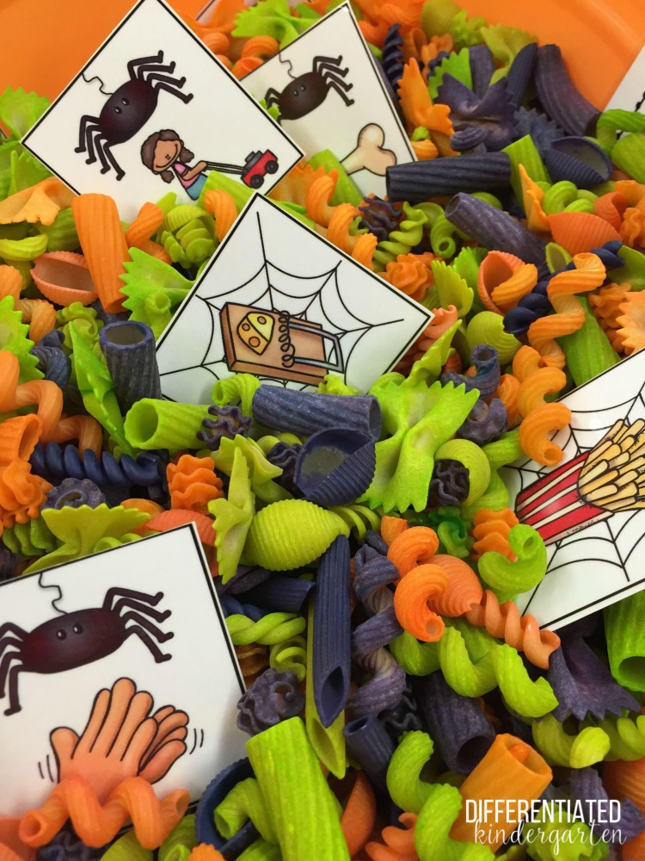
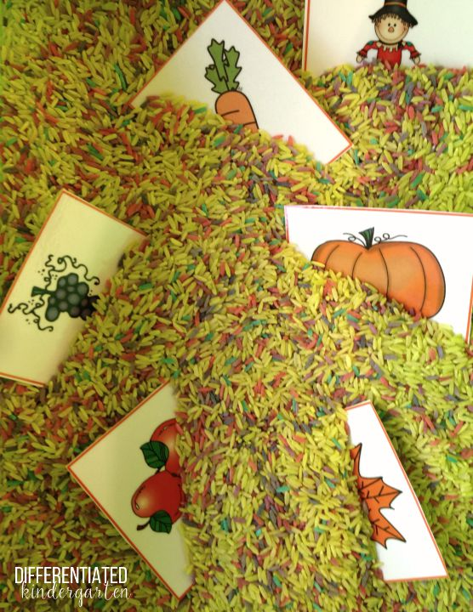
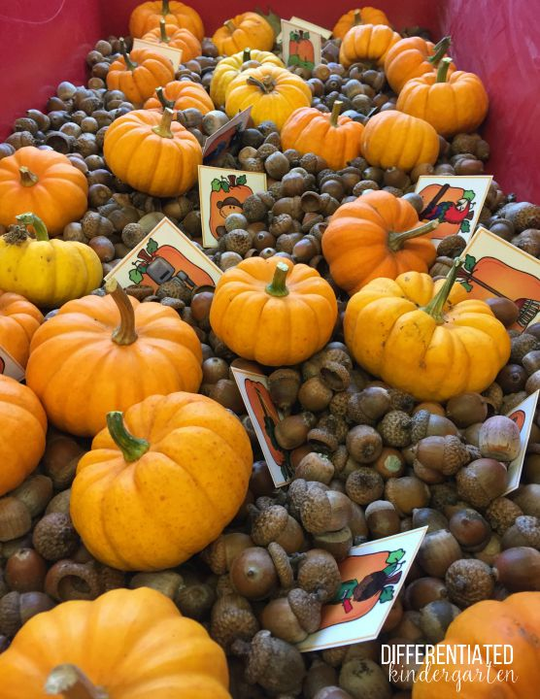
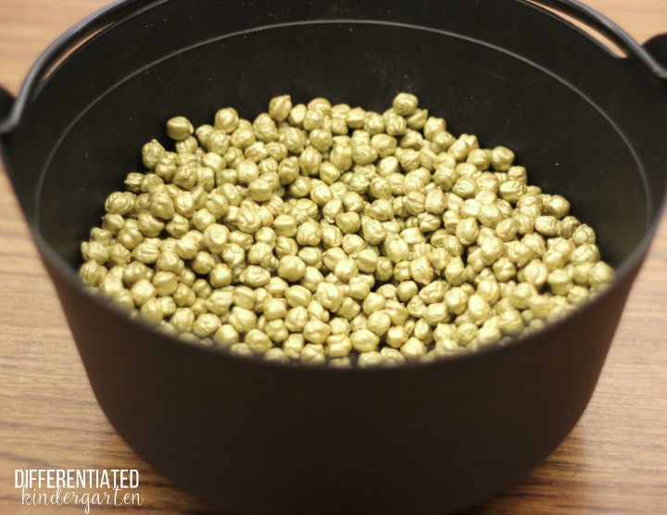
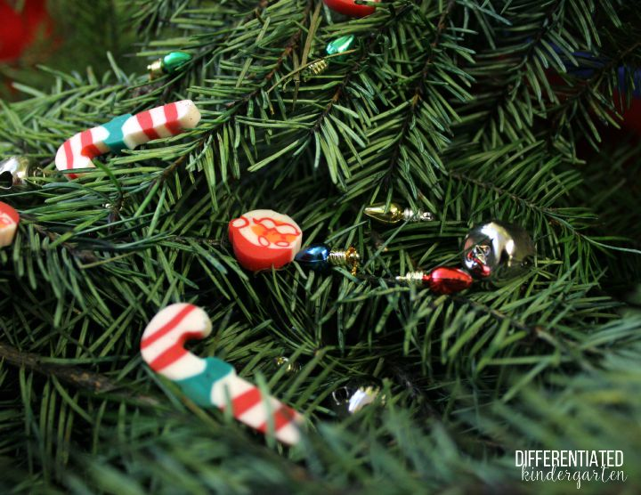
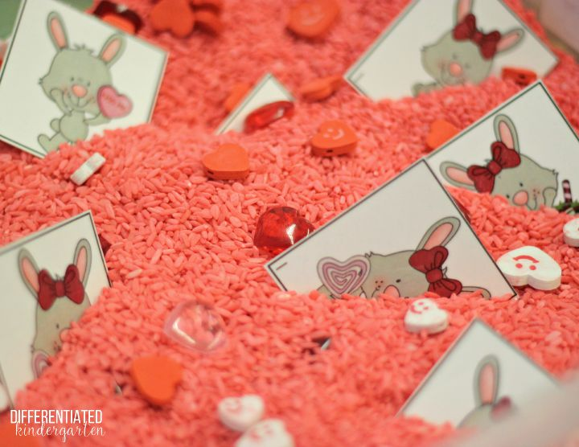
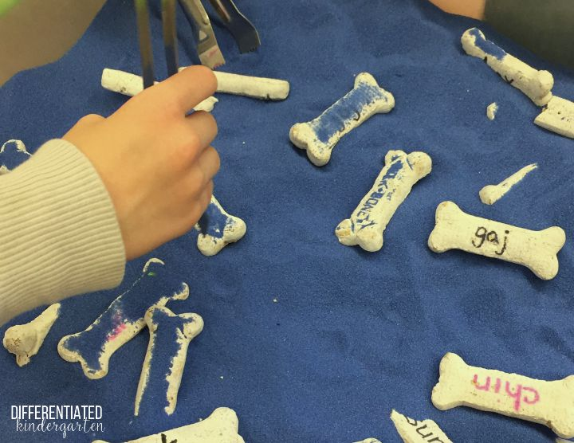

Slide 22
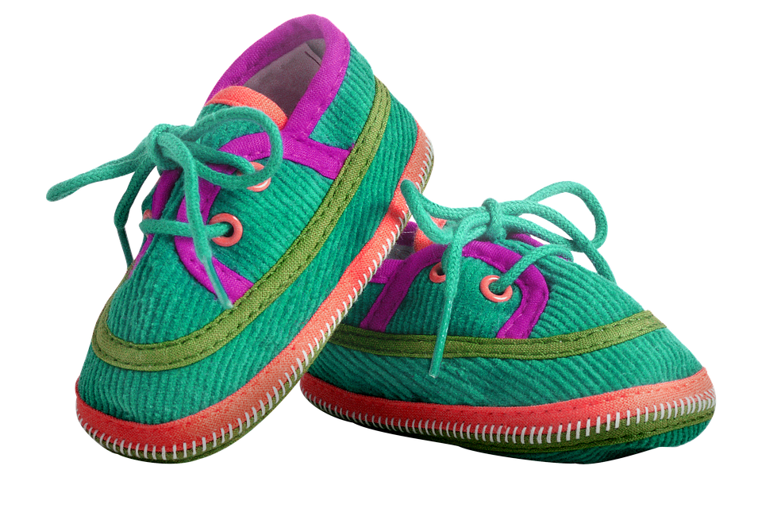
PE
Welcome to Mathews PE!
Your child will have PE 3 days a week.
Students MUST wear tennis shoes on PE days to participate.
Your child will be in a color group for specials.
If your child wants to wear other shoes on PE days, Please have them bring tennis shoes in their backpacks.
If your child needs to sit out of PE due to illness or
An injury, please send a note to school. If your
Child needs to miss more than 3 days of PE,
Please send or email a doctor’s note.
We are looking forward to a wonderful year in PE.!

Slide 23

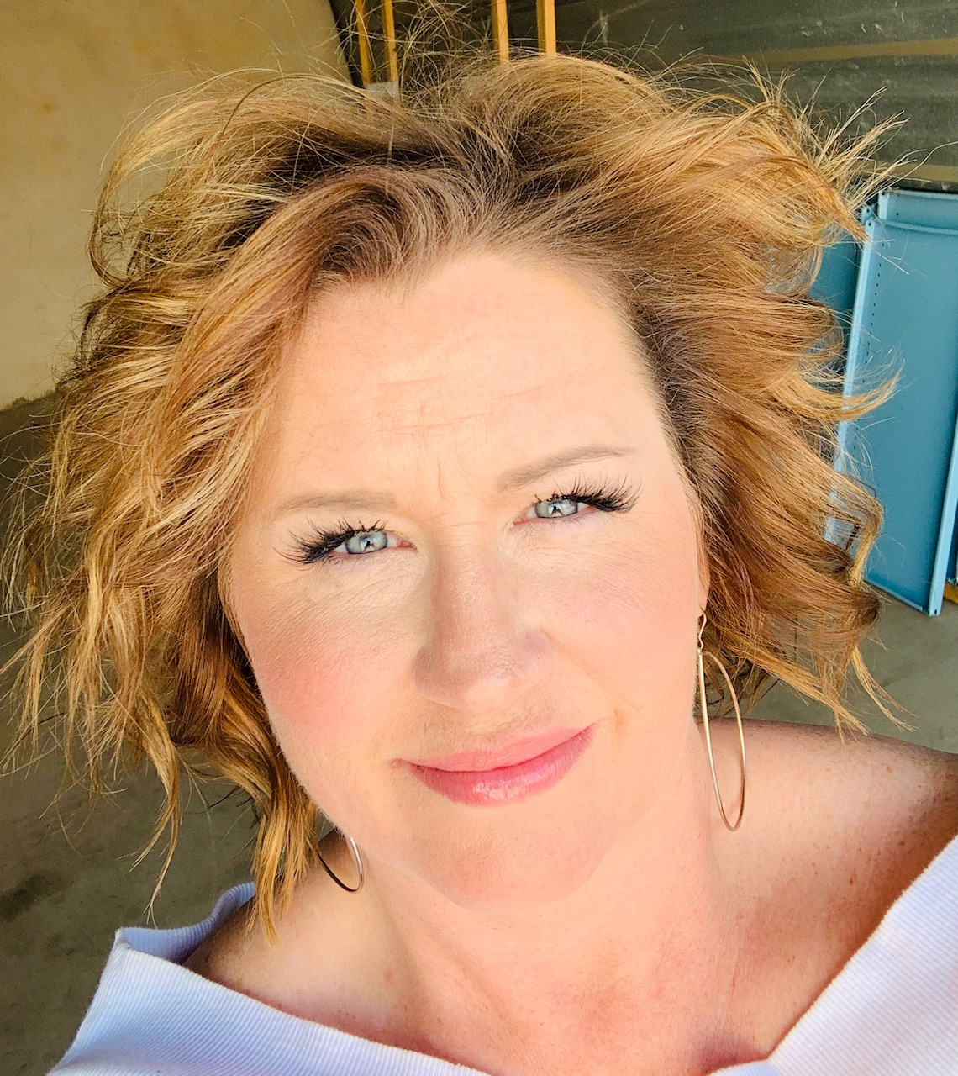
Mathews Elementary Library
Stacey Noble MLS, MEd.
Library Media Specialist
stacey.noble@pisd.edu
469-752-2328
I have been in education for twenty eight years, eighteen of which have been in the Mathews library. I love being a Mav! Before becoming a librarian, I taught second grade in Bossier City, Louisiana and then first grade at Rose Haggar Elementary here in Plano for seven years.
The library is my true calling. My grandmother was a librarian in the small town of St. Joseph, Louisiana, so this has always been in my blood. I love having the opportunity to share with students the importance of reading and showing them my favorite books!
We will have many opportunities to connect during this time of at home learning. I have a Library Google Page for each grade level from which I will be adding activities, read-alouds, and motivators. If you have not joined it yet, please be sure to do so.
We will also be having a curbside library book check-out service coming soon!
This will be a great year to be a Mav!
Happy Reading!
Notes:
Return the books

Slide 24








What does a Plano elementary school counselor do?
Teach “counselor lessons” to all student in social & emotional skills as well as moral character development (2x a month)
Work with students in small groups to develop their skills in particular areas (social skills, friendships skills, impulse control, emotion management, organizational skills, test anxiety etc..)
Help students who need immediate emotional support
Assist families and parent who need guidance on supporting their child
Organize and implement wellness theme weeks
Mrs. Toler’s
Camp Calm
Come On In!
Lauren Toler School Counselor Lauren.toler@pisd.edu 469-752-2315

Slide 25
Plano Academic and Creative Education
(PACE)
A program for students who require gifted services
2021-2022
Notes:
Should be able to just give each grade this link to put into their presentation.

Slide 26
PACE is similar to Special Education in that it is an enrichment service designed to meet the needs of a different kind of learner.
PACE is not an Honors program.

Slide 27
Students requiring gifted services may...
perform two grade levels above current grade
learn exceptionally fast
need only one to two repetitions for mastery
thrive on complexity
arrive at solutions in an unusual manner

Slide 28
If you have a child that you believe may need PACE services:
Notify your child’s teacher or the campus gifted specialist.
Complete an online referral packet. Request a hard copy if needed.
Referral packets are due September 10.
Testing procedures will be communicated after the referral deadline.
If your student participated in a gifted program at their previous school, please contact the Gifted Specialist for next steps. This communication is due to the Specialist by August 23.

Slide 29
Please contact the campus gifted specialist for specific details about the PACE program.
https://www.pisd.edu/giftededucation
Ginny Selec
ginny.selec@pisd.edu

Slide 30
Thank you for coming!

